Slide 1
Quantum mechanics for Advaitins
A (very) short course

Slide 2
The concept of objective reality
Objective reality is assumed to exist whether or not it is being observed.
Physics is the study of the universal laws governing objective reality.
Physics depends on the:
  1) Observation of a phenomenon or its absence.
  2) Communication of the observation to others.
  3) Agreement with others on the existence or nonexistence of the phenomenon.

Slide 3
Classical physics
Classical objects are assumed to have separate, independent existences whether or not they are being observed.
Classical physics is the study of the laws of motion of macroscopic objects, i.e., of objects that are directly perceivable to the human senses.
The laws of classical physics are deterministic.
This means that the state of the macroscopic universe in the future is assumed to be exactly determined by the state of the universe in the present, which is assumed to be determined by the state of the universe in the past.

Slide 4
The development of quantum physics
Classical physics could not explain experiments on microscopic objects (atoms, electrons, and photons) that were done beginning in the late 1800s.
Since 1900, quantum mechanics has been developed to explain such experiments as well as those on many other types of objects.
Because, in innumerable experiments on microscopic and mesoscopic phenomena no violation of quantum mechanics has ever been observed, it is thought to apply to all phenomena, whether microscopic, mesoscopic, or macroscopic.
The early universe is thought to have been quantum mechanical because of its microscopic size and high density.

Slide 5
Quantum theory
Quantum theory is a theory of mathematical quantum probability waves that carry no energy or momentum and are themselves unobservable.
The theory is interpreted in terms of the probabilities of observations that can be predicted from the waves.
There are many interpretations but we still don’t know if there is a “correct” one.
We will discuss a modern version of what is called the Copenhagen interpretation. In this interpretation...
...space and time are assumed to be objectively real.
...the entire physical universe, including the experimental apparatus and the observing organism, are assumed to be represented by an objective quantum probability wave that exists over all space and time.

Slide 6
Quantum wave collapse
At the moment of observation, the quantum wave is assumed to change instantly and irreversibly from representing the probability of observing any given universe to a representation of only the universe that is actually observed.
This is called quantum wave collapse.
Since the physical observing organism is represented in the quantum wave, the observation creates the observing organism.

Slide 7
What causes collapse?
Collapse must be nonlocal because simultaneous observations at points distant from each other must be consistent with each other.
Thus, collapse must have a nonlocal cause.
Because all physical processes are created in the collapse, no physical process can cause the collapse.
Therefore, collapse must be nonphysical.
The only nonphysical, nonlocal candidate we have is consciousness.

Slide 8
A subjective interpretation
Although the quantum wave is purely mathematical, it is assumed to be objective. This leads to the mysterious process of collapse.
This mystery can be avoided simply by assuming that, rather than being objective, the quantum wave represents our subjective knowledge of a situation.
A new observation changes our knowledge but, since there is no space or time, there is no mysterious wave collapse or nonlocality.
Christopher Fuchs at the Perimeter Institute in Waterloo, Ontario, Canada is working on a subjective interpretation of quantum theory.
Something like this interpretation may eventually be adopted by philosophers and, in the longer term, by physicists.

Slide 10
Big paradox: The quantum wave is purely mathematical , but is assumed to be objectively real!
The quantum wave is assumed to exist objectively, i.e., it is assumed to exist even though it itself cannot be observed.

Slide 11
Daring prediction!
Quantum wave collapse or branching will never be understood objectively because it starts with an impossible assumption…..
that the quantum wave is objective when every physicist knows that it is just a mathematical formula!

Slide 12
Conclusion:
Any interpretation of quantum theory that assumes objective space and time is nonlocal.
Nonlocality of observations has no physical explanation. (Nonlocality of the wave is different and has a physical explanation.)
The only alternative is a subjective interpretation in which space and time are purely conceptual rather than objective.
A subjective interpretation would have no mysterious problems of collapse, branching, or nonlocality.

Slide 13
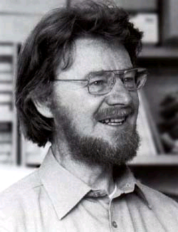
Bell’s theorem
(John Stewart Bell, 1928-1990)
Bell devised a way to determine experimentally whether reality could be described by local, real theories (i.e., local, hidden variable theories) by deriving an inequality that was valid only if local, real theories were valid.
The inequality depended only on experimentally measured quantities, hence it was independent of any specific theory. Any violation of the inequality would prove that reality cannot be both local and real.

Slide 14
Many experiments have shown that objective reality violates Bell’s inequality
Thus, objective reality cannot be both local and real.
Furthermore, using Bell’s inequality, Aspect, et al. (1981-82) showed that reality is nonlocal.
Then, Gröblacher, et al. (2007) showed that, if hidden variables describes reality, reality must be bizarre and counterintuitive.
However, even before these experiments had been done, physicists had largely abandoned the assumption of real particles. Thus, they had abandoned the assumption that particles exist if they are not observed.

Slide 15
The philosophy of materialism
(pure objectivity)
(Earliest materialists: Atomists Leucippus, Democritus, and
Epicurus: 460-270 BC)
Everything is assumed to be matter (or, at least, it is governed by physical law).
Space , time, and matter are assumed to be objective—they are assumed to exist whether or not there is an observer.
If consciousness exists, it is assumed to be an epiphenomenon of matter with no independent existence of its own.

Slide 16
A third daring prediction!
Both the Copenhagen and many-worlds interpretations will eventually either be abandoned or will be made purely subjective by assuming that the wavefunction is a tool for calculating subjective probabilities, instead of being objectively real.

Slide 17
Objective reality (cont.)
In addition to the assumption of separation, objective reality has three other components:
  1) Observation of an object or its absence.
  2) Communication of the observation to others.
  3) Agreement with others on the existence or nonexistence of the object.

Slide 18
In the late 1800s, problems arose with classical physics
It could not explain certain experiments (e.g., blackbody radiation, the photoelectric effect, and line spectra of atoms).
After 3 decades of trying to make classical theory work, physicists replaced it with quantum theory in the 1920s. (Why did it take so long?)
In order to get a theory that successfully explained the experiments, physicists had to abandon the basic assumption that objective reality consisted of separate, independently existing, observable objects!

Slide 19
The development of quantum theory
Like classical theory, quantum theory was formulated to describe only measurements on objective processes.
At first, it was intended to describe only measurements on microscopic processes, but now it is assumed to describe measurements on all physical processes, from those of elementary particles to those of the entire universe.
It is the only physical theory we have at the present time. (Classical physics is a good approximation for macroscopic masses.) If it is incorrect, we have as yet no other theory to replace it.
In every direct and indirect experimental test of quantum theory so far, the basic principles have never been shown to be invalid.

Slide 20
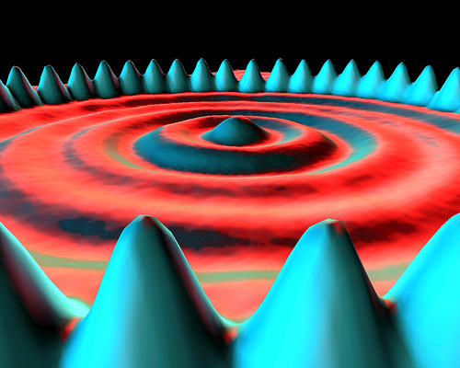
Are there any quantum objects here?
Measured probabilities of locations of “iron atoms” forming a circular ring of peaks surrounding probabilities of locations of “electrons” forming continuous circular rings. The “surfaces” are densely packed point measurements. But, only positions were measured, not objects!

Slide 21
The statistical interpretation of quantum theory
Currently, only the statistical interpretation, which states that quantum theory correctly predicts the average value of an observation when it is repeated many times (e.g., the average of many position measurements).
It is purely subjective provided there is no objective wavefunction and provided both the prediction and the observation are subjective.
If it is purely subjective, there are no problems of collapse, branching, and nonlocality because they all result from the assumption that the wavefunction is objective.

Slide 22
There are three general types of interpretations of quantum theory
Interpretation in terms of purely objective reality (objective interpretation).
Interpretation in terms of Cartesian dualism (objectivity plus subjectivity).
Interpretation in terms of purely subjective reality (subjective interpretation).

Slide 23
A purely subjective interpretation of quantum theory
Currently, the only possible purely subjective interpretation is the instrumentalist interpretation, which states that quantum theory correctly predicts the probability that an observation will yield a specific result (e.g., the probability that a position measurement will yield a specific position).
This is purely subjective if there is no objective wavefunction and both the prediction and the observation are subjective.
If it is purely subjective, there are no problems of collapse, branching, and nonlocality because they all result from the assumption that the wavefunction is objective.

Slide 24
The next observation
After an observation and quantum wave collapse, a new quantum wave emerges.
It represents all of the possibilities that are allowed by the previous observation.
Another observation results in another quantum wave collapse, etc.
In this interpretation, a single collapse is not perceivable because a perception requires time. Thus a perception requires a sequence of collapses.

Slide 25
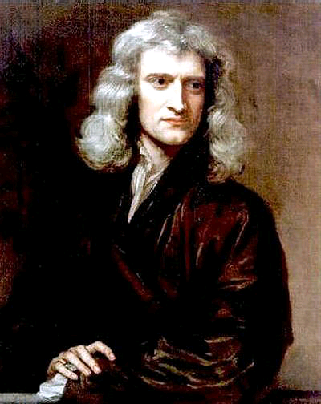
Classical physics (1687-1900)
Isaac Newton (1643-1727)
Classical physics is materialistic and objective. Consciousness is not part of the theory.
Classical objects are assumed to have separate, independent existences whether or not they are being observed.
They are assumed to have definite properties, such as position and velocity, whether or not these are being observed. These properties are assumed to have no intrinsic uncertainties.

Slide 26
The Copenhagen interpretation
Born, Heisenberg, Schrödinger, Bohr (1925-1927)
The Copenhagen interpretation was devised in order to apply quantum theory to single measurements as well as to repeated measurements.
Even though the Copenhagen interpretation is supposed to be the “orthodox” interpretation, there is widespread disagreement on it.
Some physicists think it is purely objective without the need for a conscious observer.
Some physicists think it is partly objective and partly subjective (a conscious observer is needed).
And a few (very few) think both the wave and the observations are subjective.

Slide 27
In an objective or partly objective Copenhagen interpretation…
Space and time are assumed to be objectively real.
The universe and all experimental apparatus is assumed to be represented by an objective quantum wave that exists over all space and propagates through time.

Slide 28
What does quantum theory describe?
Since microscopic objects are not perceivable by the human senses, quantum theory predicts the results of observations , not the behavior of preexisting objects.
Both predictions and observations can be made without assuming the existence of preexisting objects.
For example, we can measure the signals from two position sensors and a timer and calculate a velocity without ever perceiving a moving object traveling between the sensors in the measured time interval (cf. neutrino velocity measurements).
The existence of a preexisting moving object is only an assumption.

Slide 29
Locality and nonlocality
Locality: No physical effects can travel faster than the velocity of light.
Nonlocality: Observations at one point may be correlated with observations at another point even though no local effect could travel fast enough to produce the correlations.
In classical theory, there are no nonlocal effects.
Because simultaneous observations at different points in space must be consistent with each other, quantum wave collapse must occur over all space simultaneously, hence it is nonlocal.
After 85 years, quantum wave collapse is an embarrassment to physicists because it is still not understood…!

